Slide 1
Introduction to PowerPoint
Geoff Snowman

Slide 2
What is PowerPoint Good For?
Presentations

Slide 3
What Slide Format is Used Most?
Bullet Points
Bullet points are sentence fragments that begin with a bullet.
Bullets are often squares or circles.
There are other types of bullets that are more decorative.
Animated builds are used so that not all bullets appear at once.

Slide 4
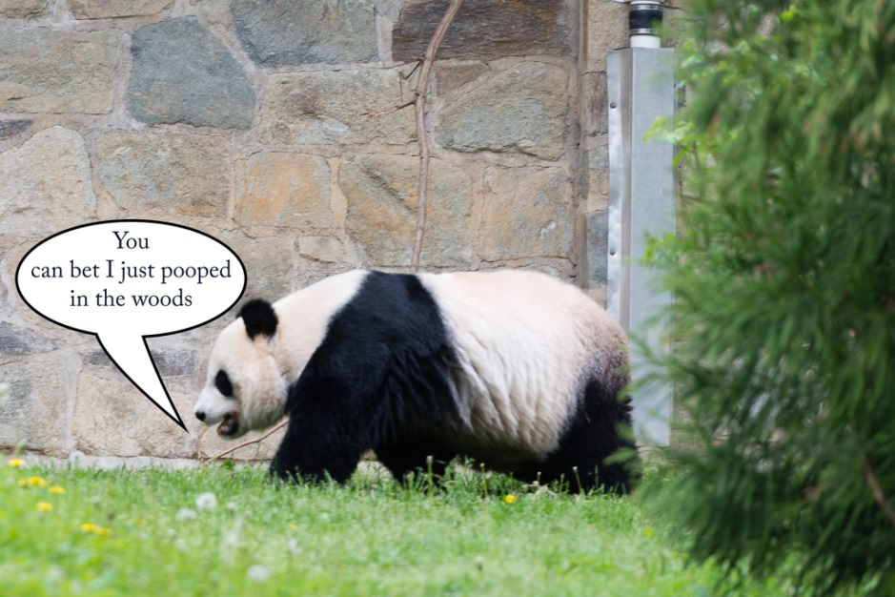
You Can Also Use Pictures

Slide 5
Or Word Art
This is
Word Art

Slide 6
Or Smart Art
Lists
Blocks
Cycles
Arrows
Better than Bullets

Slide 7
You can use transitions between slides

Slide 8
Any Questions?

Slide 9
PowerPoint Skills
New Slide Deck
Adding Slides
Slide Layouts
Adding Pictures
Word Art
Smart Art
Selecting a Design
Changing Designs
Builds and Animations
Transitions
Slide Sorter
Notes Page
Handouts

Slide 10
PowerPoint Exercise
Create a 5-7 slide PowerPoint that describes your favorite TV show, movie, or book.
Content ideas:
Why I like it
What it’s about
Plot
Characters
Favorite Episode
Other shows or movies like it
Other shows or movies with the same actors

